Slide 1
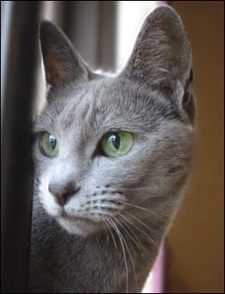
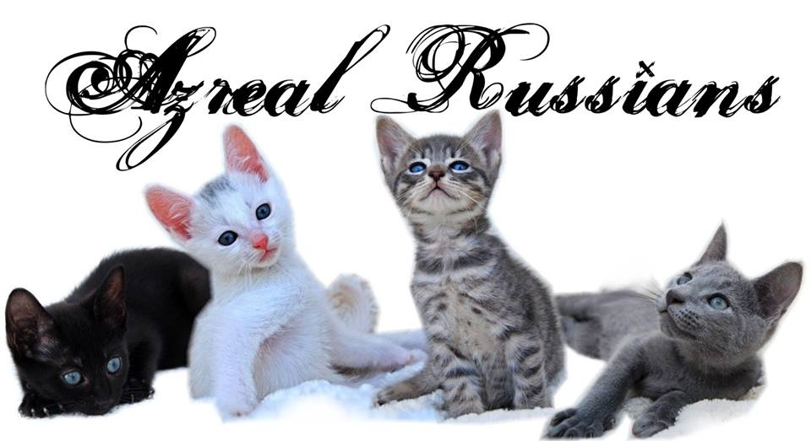
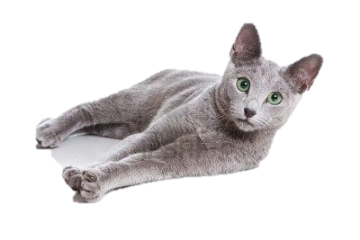
THE RUSSIAN
History of the Russian Blue Cat
The Russian Blue is a naturally occurring breed that originated in the port of Arkhangelsk, Russia
It is believed that the first Russian Blues were brought from the Archangel Isles to England and Northern Europe in the 1860s by sailors. The first recorded showing of the breed was in 1875 at the Crystal Palace in England as the Archangel Cat. The Russian Blue competed in a class including all other blue cats, until 1912, when it was given its own class. Due to a lack of numbers of the Russian Blue prior to World War II, Siamese were used to cross breed with the Russian Blue. The Siamese trait has since been bred out.
From Russia, to Europe, to the US and Australia, and now throughout the world Russians are bred.
In the 1970’s, Australian Mavis Jones bred a Russian White by mating a Russian Blue to a white domestic cat, around the same time the Russian Black was also reintroduced as well as the Russian Spotted Tabbies.
Appearance of the Russian Cat
The Russian has a lean, elegant & long body, accompanied by a long tail. The Russian is a medium sized cat, with a coat that resembles liquid platinum. The solid blue-grey double coat is short, soft as silk, very plush, and silver tipped. The Russian is often referred to as the cat with the “drunk donkey” look, due to its upright ears, almond shaped vivid green eyes and knowing smile.
Females are smaller than males.
Russians tend to weigh between 3–6 kg. The accepted eye colour for the breed is vivid green.
Coat colours are:- Blue, Black, White & Spotted Tabby
Characteristics
The Russian life expectancy is 10 – 15 years, sometimes longer. They are healthy, hearty cats and appear to have a sense of humour.
Russians are quiet and gentle cats that like their routine. The Russian is known for being a very intelligent, curious, and tranquil animal. They have been known to play fetch, and are sensitive to basic human emotions. The Russian also develops extremely loyal bonds to their loved one and are suited to indoor living.

